Slide 1
Introduction to patents and patent information
Manchester
24 April 2017
Irene Kitsara, IP Information Officer
Access to Information and Knowledge Division

Slide 2


World Intellectual Property Organization (WIPO)
UN specialized Agency in Geneva, Switzerland
189 Member States
1200 staff members
26 WIPO-administered treaties
Dedicated to promote a balanced and efficient international intellectual property (IP) supporting creativity and innovation
www.wipo.int
https://www.youtube.com/watch?v=pYZxqJCno44

Slide 3


What is protected by IP?
I have an idea….
Is the idea as such protected?

Slide 4
Why IP?
Recognition and monetization of creativity and innovation
Amortization of investment and efforts of innovators/creators
System of protection and guarantee of rights of creators
Legal basis for the protection of rights of the creators/innovators

Slide 5
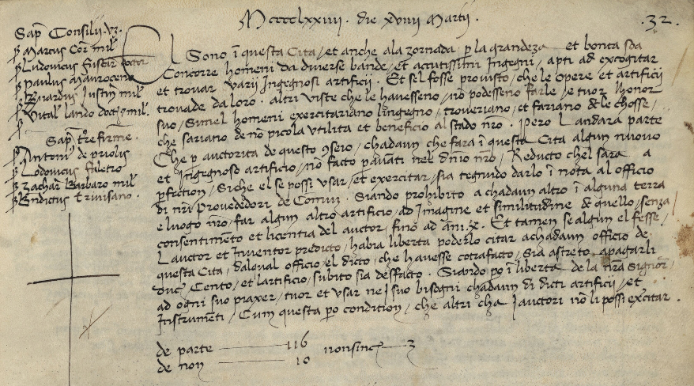
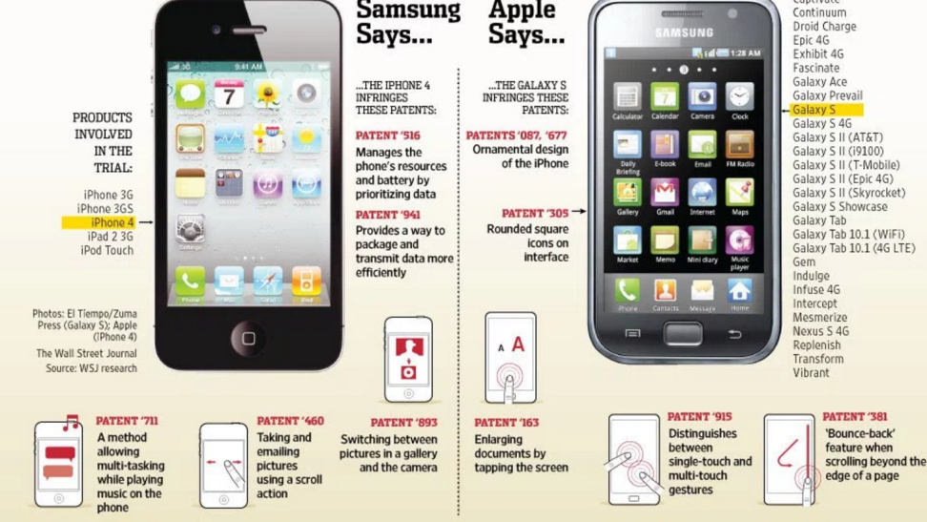
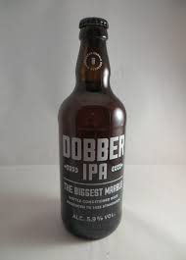


History of Intellectual Property
Or…?
A recent trend?
Venetian Patent Statute (1474)

Slide 6
Types of IP Rights (IPR)
Patents
Trademarks
Industrial Designs
Geographical Indications
Copyright

Slide 7
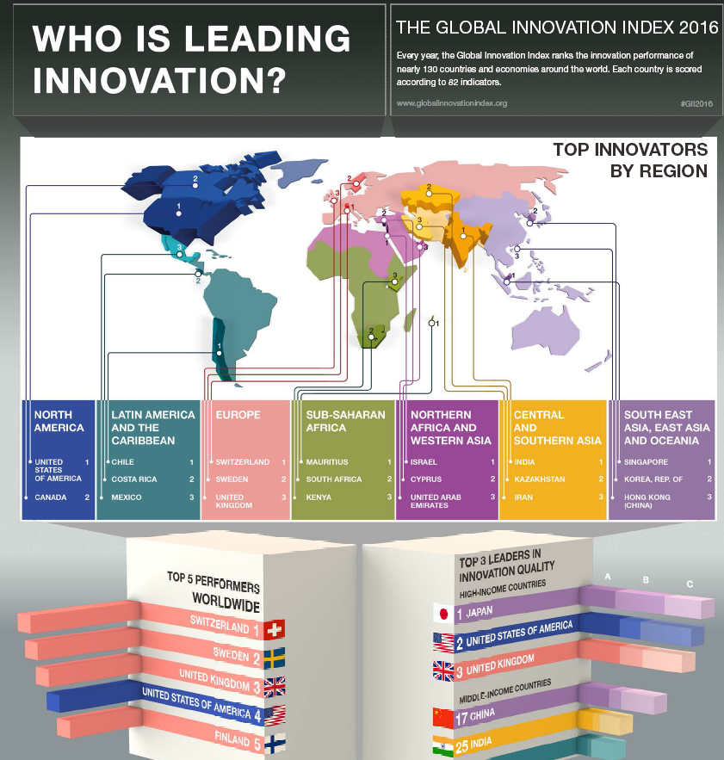

Global Innovation Index 2016

Slide 8
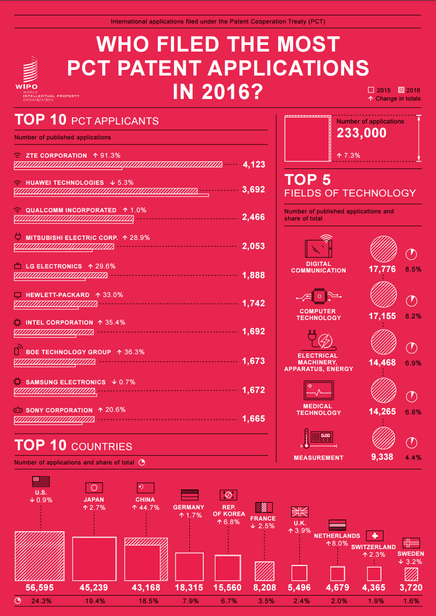
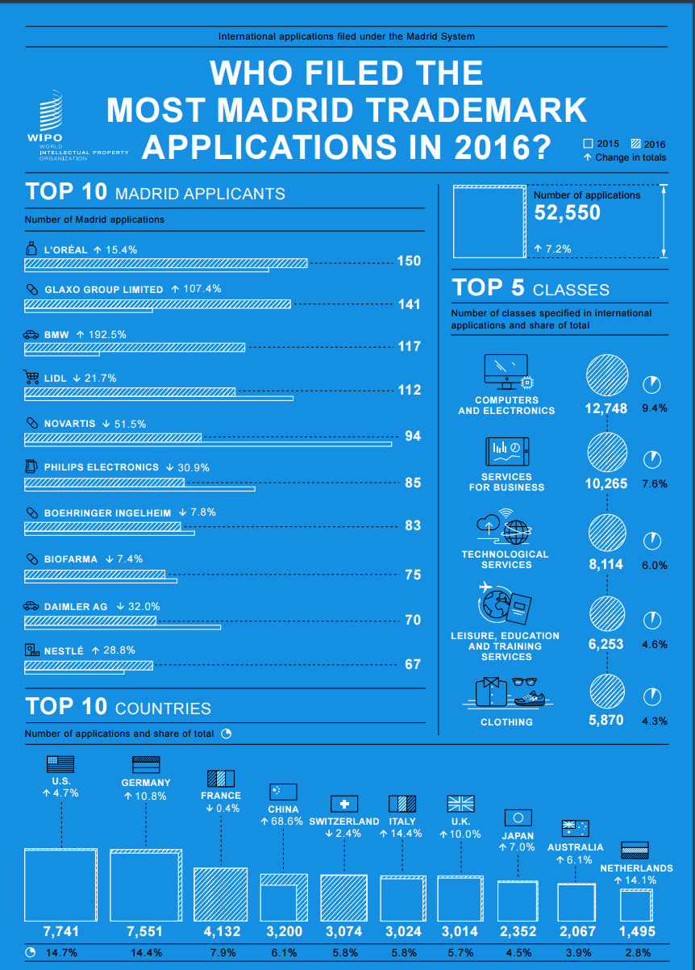
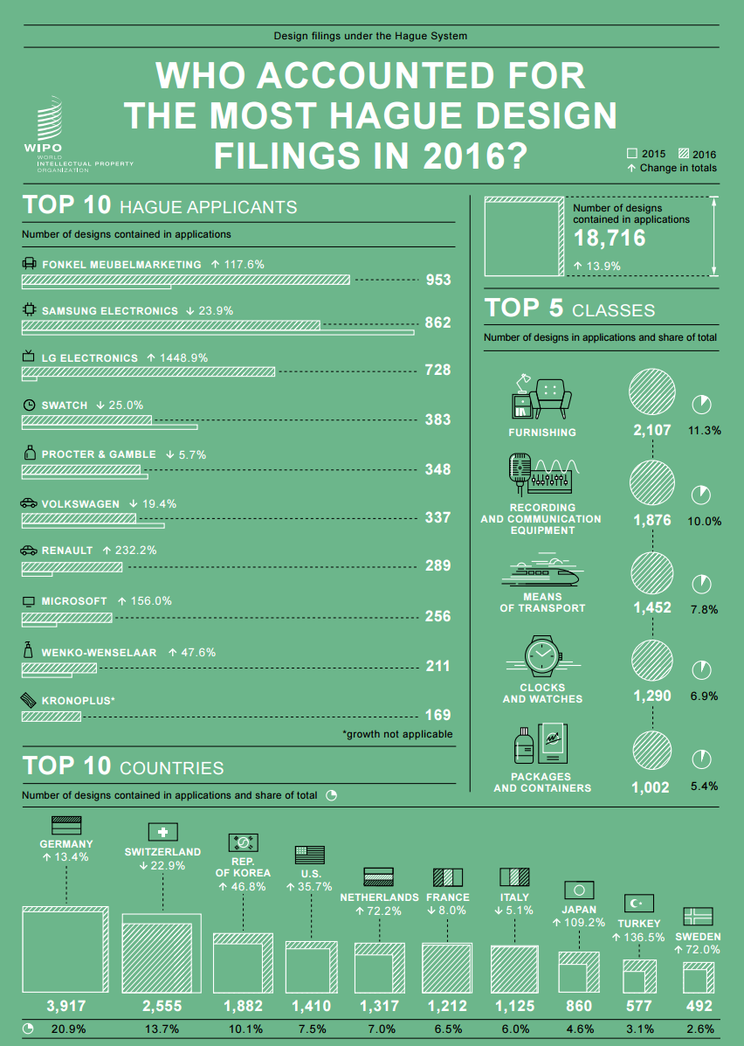
The use of the IP system globally and the position of the U.K.

Slide 9
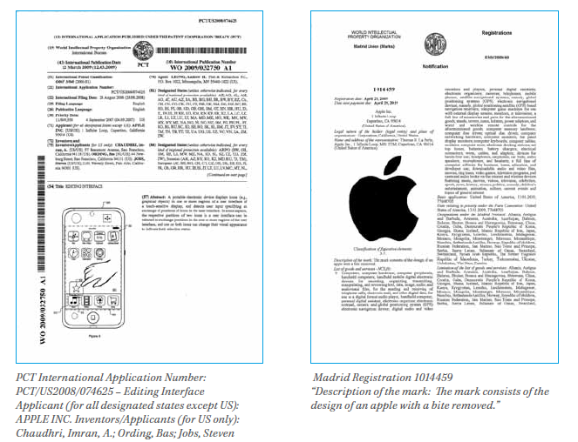
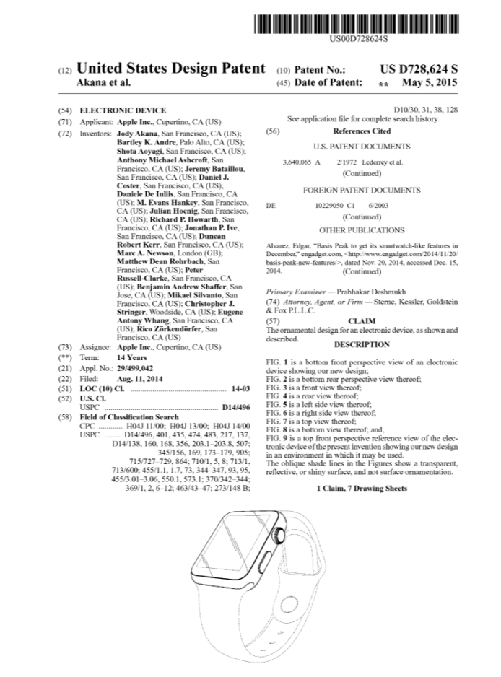
Patents, designs and trademarks of Apple

Slide 10
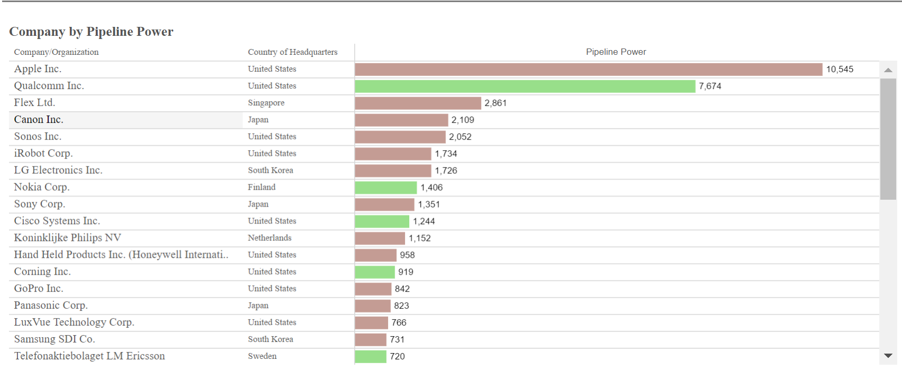
Think of companies like Apple….
IEEE Patent Scoreboard 2016(Electronics and Communication/IT Equipment)
Apple: success linked to innovation and use of IP system. PATENTSCOPE: “Apple Inc” appears as patent applicant on 26.764 patent applications.
IP rights: company’s asset increasing negotiation power and assisting in market dominance

Slide 11

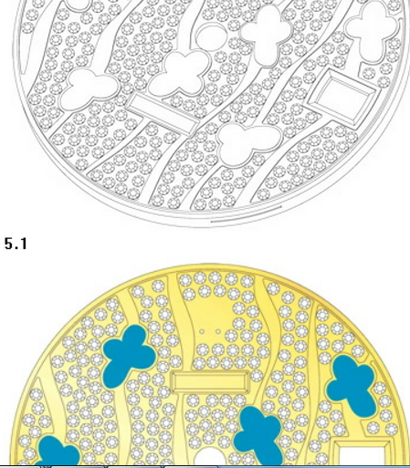
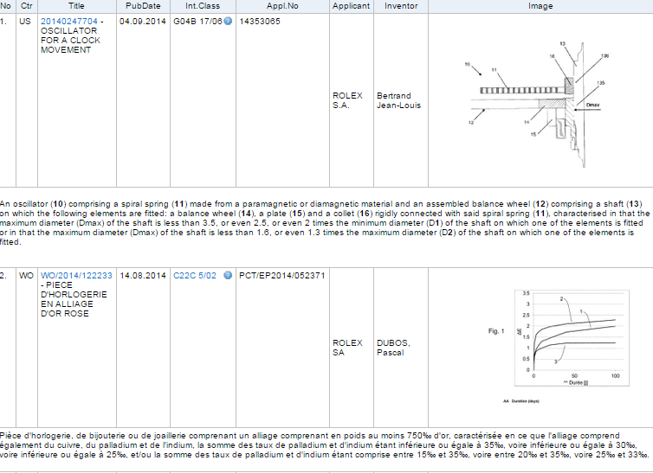
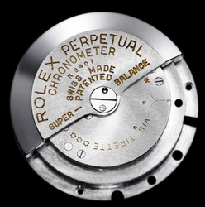

IP Rights Bundle
Industrial designs
Trademarks
Patents
www.rolex.com

Slide 12
IPR selection criteria
Key considerations:
Technology domain
Preliminary protection of research results
Ease of commercialization
Market definition
Level of competition and position in the market
Costs and funding
Risks/Risk management

Slide 13
Patents: Is an invention patentable?
Patentability criteria:
Patentable subject matter
Novelty requirement
Inventive step (non-obviousness) involved in relation to the state of the art
Industrial applicability

Slide 14
The functions of a patent
A. Protection: A patent is an exclusive right granted for an invention (product or process providing a new way of doing something/offers a new technical solution to a problem). The patent owner can prevent or stop others from commercially exploiting the patented invention.
B. Disclosure: To get a patent, technical information about the invention must be disclosed to the public in a patent application and explained in a sufficiently detailed manner for a person skilled in art. Patent application available on primary and secondary sources of patent information

Slide 15
Patent granting process
Application
Formal examination
State of the art search
Substantive examination
Publication
Decision to grant
Opposition
Appeal

Slide 16
Patent territoriality
Protection only in the geographical area where patent protection is sought:
National protection
Regional protection
European and unitary patent
OAPI, ARIPO, EAPO etc.
Protection in multiple countries (Patent Cooperation Treaty - PCT)

Slide 17
Questions related to the acquisition of an IPR
Is my idea new and inventive?
Is there a market for my invention?
Could I protect my invention through a patent?
Is the patent the right way to protect my invention?
Patent information:
Information included in patent documents (technical, legal and business information). Helps in answering some of these questions

Slide 18
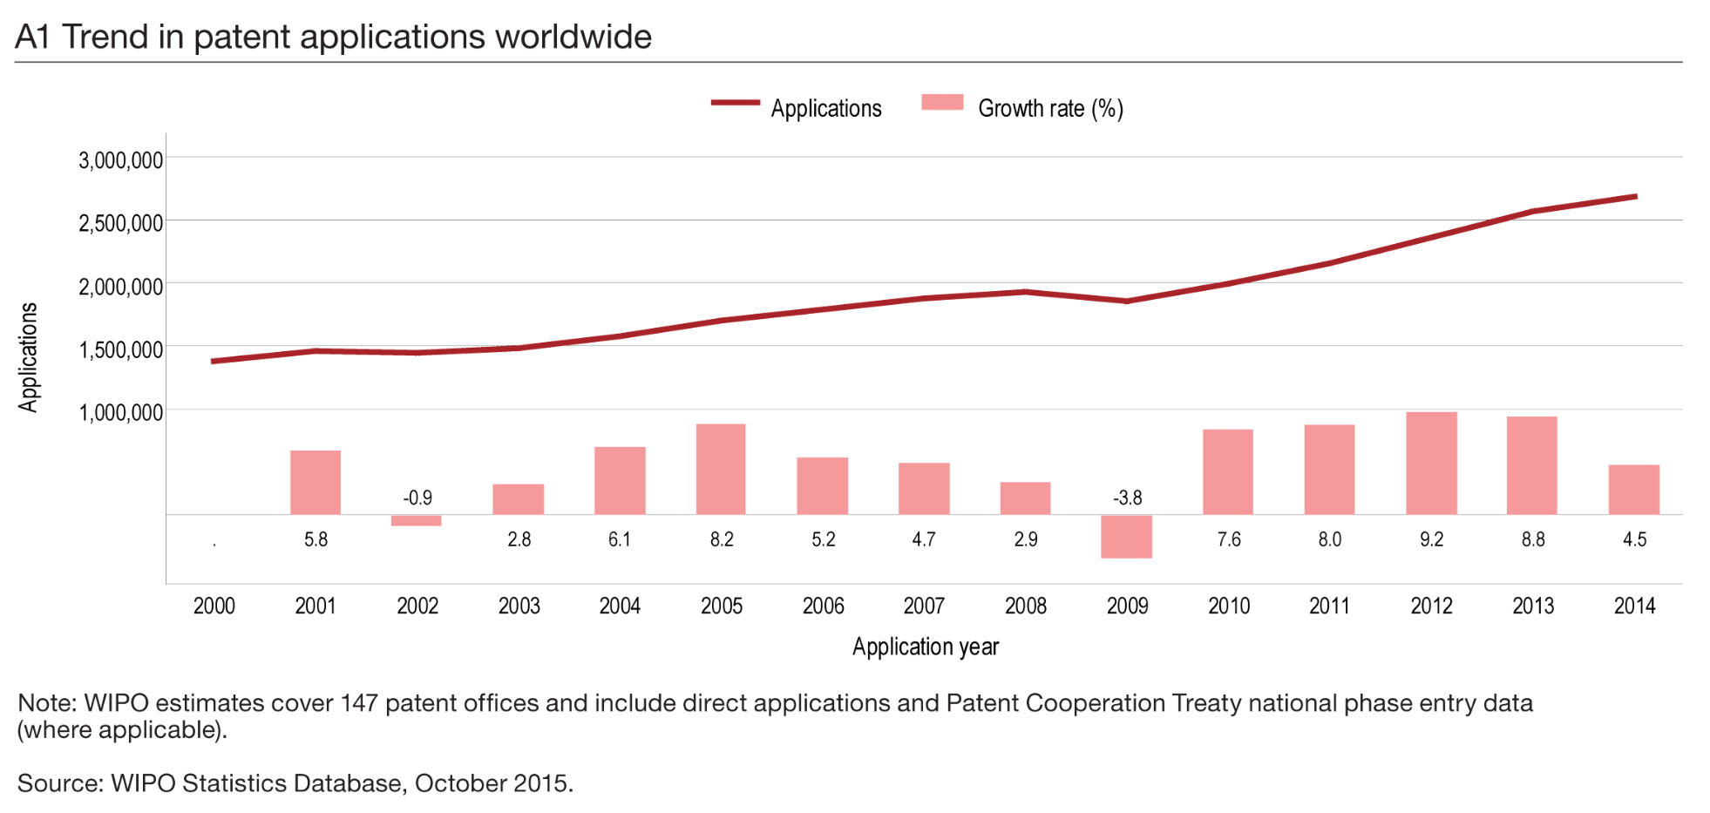
The growing importance of patent information
Increase in number of patent applications over time
Increase in the volume of information included in patent documents and interest to access this information
Currently: over 110mio patent documents. PATENTSCOPE: over 60mio

Slide 19
Nature of patent information
Patent protection is territorial
Patent information is global
Patent protection is limited to what is described in the claims
Patent information includes all information included in patent documents:
Technical
Legal
Business
Patent protection is limited in time
Patent information remains always available

Slide 20
Searching patent information
What? → Patent Documents
Why? → Different types of patent search
Where? → Patent Databases
How? → Patent Search Strategy/Methodology

Slide 21
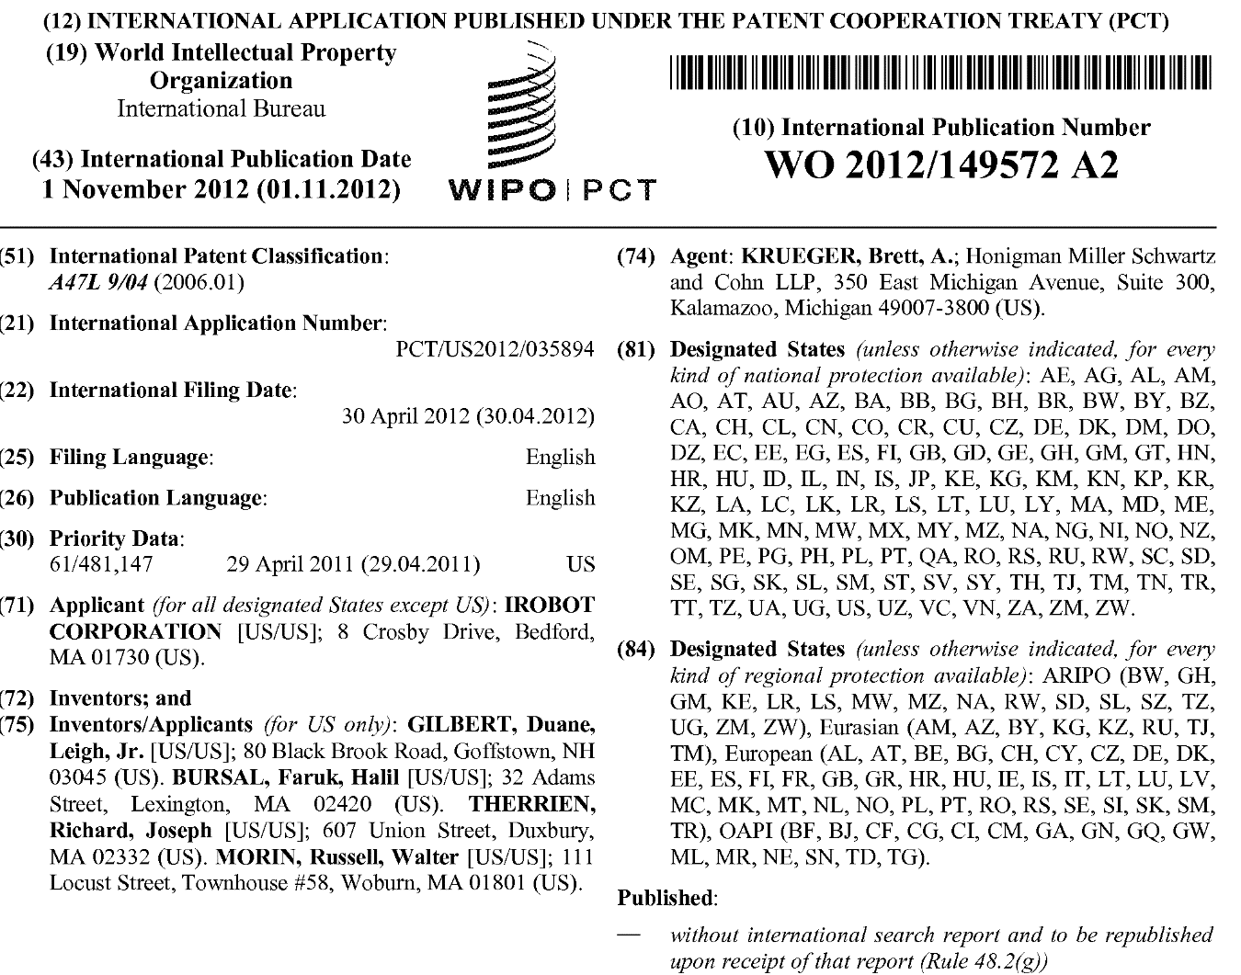
Bibliographic Data/Front page
Publication number
Publication Date
Classification
Application number
Designated
States
Application date
Priority date
Applicant
Inventor

Slide 22
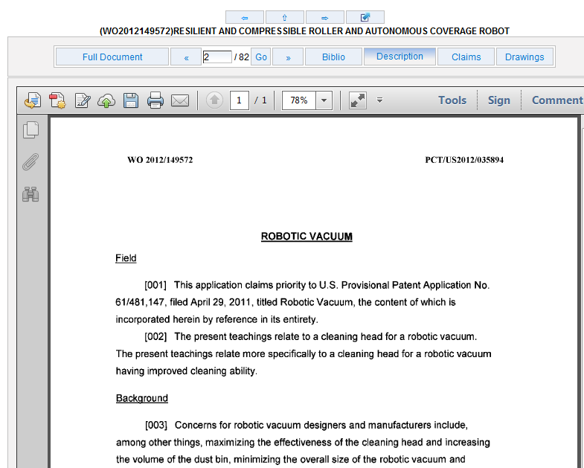
Descriptions
Describes how the invention works
Provides key information related to the problem
Indicates the known solutions before the invention

Slide 23
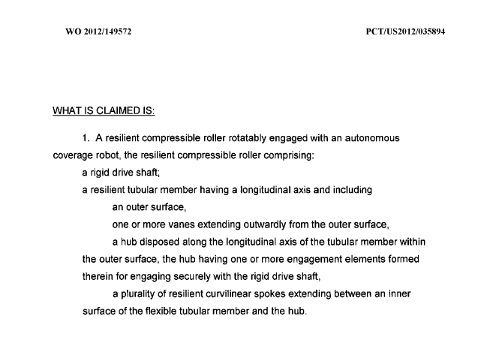
Claims
Defines the scope of patent protection – the legally binding part of the patent document

Slide 24
Databases
Differences:
Geographical coverage
Historical coverage
Languages
Data collections (bibliographic data vs. fulltext)
Document types (patent applications/grants)
Search fields and search operators

Slide 25
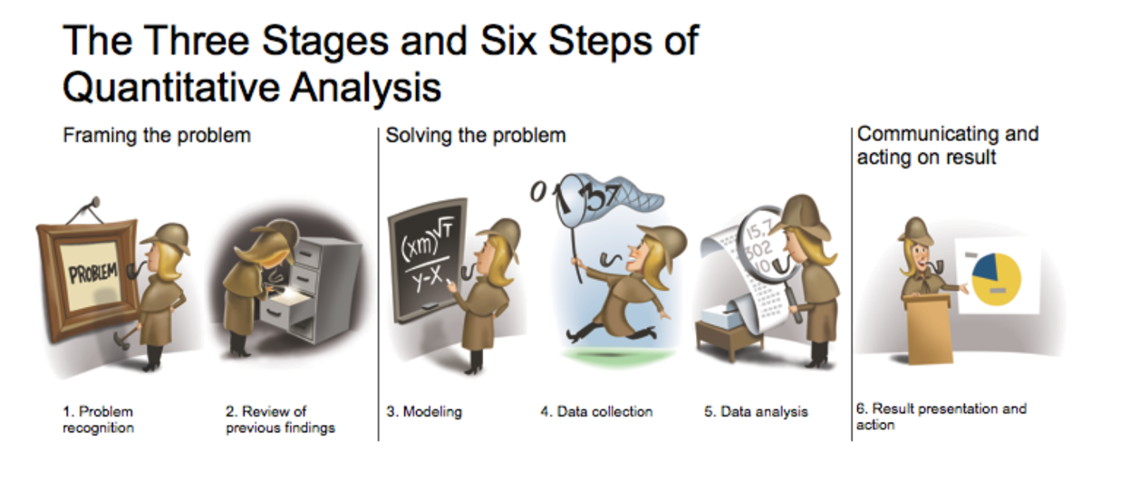
The patent analysis quest
Keeping Up with the Quants, Davenport & Jinho Kim, Harvard Business Review Press, 2013
Good questions – increased chances for good answers
Good quality of data – good quality of analysis
Where is the data?

Slide 26





Data sources
Non-patent data
Patent data
Primary source of information
Patent Gazettes/Bulletins....
Secondary sources of information
PATENTSCOPE
Esp@cenet
The Lens
Other free databases
Commercial Databases...

Slide 27
The importance of obtaining data
Right source of information
Understanding of parameters and limitations of the source
Confidentiality issues?
Where will the data feed into?
Is my data format compatible with the tool I want to use to clean/tidy/analyze and visualize the data?

Slide 28
PATENTSCOPE https://patentscope.wipo.int
LENS https://www.lens.org

Slide 29
Irene.Kitsara@wipo.int

